Slide 1
FC BARCELONA
TACTICS
LINE-UP

Slide 2
Tactics
Attacking chances creation
Passing speed style: [0,10] -> 0 means long passes, 10 short passes, 5 mixed
Crossing : [0,10] -> 10 means a lot of crosses.
Long shots: [0,10] -> 10 means a lot, 0 only shot from very good positions
Attacking mentality: [0,10] -> 0 defending with all players in own half, 10 attacking a lot, defenders are constant above the middle of the pitch.
2. Offside trap -> depinde de skill-ul fundasilor. Random vor iesi prost in functie de asta.
Pressing -> [0,10] afecteaza stamina daca punem la maxim iar jucatorii pot cadea fizic rapid daca nu au skill-ul mare.
Defending aggressiveness: [0,10] -> 10 foarte agresivi la tackling pot lua cartonase mai des.

Slide 3
Name GK Att Phys ..
Line-up
1 Tatarusanu 19 2 2.4 1.9
2. Tanase 0 15 19 1.4
………………………………….
Notes:
1. Tatarusanu
Using drag and drop to move players to a specific position.
When clicking a player you’ll see a page with detailed info about him – see next slide
Tactic selection: list box with all tactics.

Slide 4
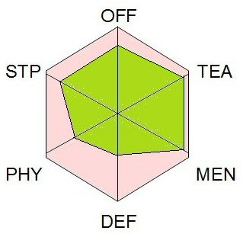
ION POPESCU
Speciality
Age: 25
Height: 1.75 m
Foot: Right
ATAC
Finishing 56
Long Shots 65
Off the ball 56
Creation (Flair) 45
Technique 87
Dribble 87
Header 98
DEFENSIVE
Tackle 56
Marking 54
Positioning
Aggression
Header
Long Shots
PHYSICAL
Agility 78
Acceleration …
Speed
Stamina
Strength
Injury proneness
Balance
MENTAL
Teamwork 35
Aggression ..
Tenacity
Vision
(aici vor fi alte statistici cu privire la
Jucator: forma in ultimele meciuri,
Goluri date, aparitii, etc.)
TEAM
Passing 94
Vision 90
Teamwork ..
Crossing
Creation (Flair)
Off the ball
SET PIECES
Free kick 88
Penalty ..
Corner
Throw-in

